Slide 1


Minor Project
Title: Emotion-Personality Detection System
Presented by:
R2142211117- Aryan Mankotia
R2142211358-Anmol Sharma
R2142211010-Dhruv Sharma
Mentored By
Virendra Kadyan

Slide 2
Content
Introduction
Literature Review
Objectives
CNN and its Components
QR Code for SRS
Methodology
Working model
References

Slide 3
Introduction
Emotion Personality Detection System is a minor project that aims to develop a system capable of analyzing facial expressions to determine both the:
emotional state and
personality traits of an individual.
This project combines computer vision and machine learning techniques to gain insights about user’s personality traits from facial images.
Problem Statement
The problem at hand is to design, develop, and deploy an intelligent machine learning system that can accurately detect and analyse facial emotions from a user's face in real-time and subsequently provide valuable insights into their personality traits

Slide 4
Technical Concepts (Algorithms)to Use:
Machine Learning Models: Utilizing machine learning algorithms such as Convolutional Neural Networks (CNNs) or Support Vector Machines (SVMs) for emotion classification and personality trait prediction.
Dataset and Input Format
We will be using a dataset(FER,2013) of facial images with three labels:
Pixels: These are the pixel values of the facial image, which serve as input data for the algorithms.
Usage: Describes for what purpose the image is being used for training or testing.
Emotions: The labeled emotions expressed in the images (e.g., happy, sad, neutral).
Area of Application
Mental health monitoring: Tracking emotional changes for early intervention.
Educational tools: Enhancing learning experiences by adapting content to individual personality traits.
Market research

Slide 5
Literature Review
[1] introduces a CNN-based approach for facial expression recognition, which is a fundamental component of emotion detection and a key component for our project. The primary focus is on accurately classifying facial expressions into distinct emotion categories, including happiness, sadness, anger, surprise, fear, and disgust.
In [2], we get an overview of deep learning techniques for facial expression recognition. The authors review several benchmark datasets commonly used for training and evaluating deep learning models in facial expression recognition. They discuss the characteristics and challenges associated with these datasets.
[3] discusses a method that uses CNNs and mapped binary patterns for facial emotion recognition in uncontrolled environments.
From [4], we get an insight in the correlation between emotion expressions like fear, anger, happiness and personality traits like openness, agreeableness, extraversion etc. It also proposes a novel multitask learning framework.

Slide 6
In [7] this paper, the authors aim to predict personality traits by analyzing facial features. They begin by introducing the background and motivation behind the study—why it's important to understand and automate the process of perceiving personality traits from facial expressions. The authors propose a methodology or framework for their study, detailing how they collected facial data and how they associated specific facial expressions with certain personality traits. They used CNN machine learning algorithm for this purpose.
In [8] In this paper, the authors Z. Meng explore the use of facial expression analysis to automatically predict personality traits. They start by providing background information on the relevance of personality traits and the challenges in predicting them. The authors introduce a methodology for analyzing facial expressions in relation to personality traits. This involves the use of computer vision techniques, machine learning algorithms (CNN), to extract meaningful features from facial expressions.

Slide 7
Objectives
MAIN OBJECTIVE
Personality Trait Prediction:
Personality Assessment: Create machine learning models capable of predicting personality traits, such as extroversion, introversion, agreeableness, conscientiousness, and openness to experience, based on facial cues.
The primary objective of this project is to develop a machine learning model that accurately detects facial emotions from a user's face and provides insights into their personality traits.
SUB OBJECTIVE
Emotion Recognition:
Real-time Emotion Detection: Developing a model that is capable of accurately detecting and classifying human emotions from facial expressions in real-time.

Slide 8
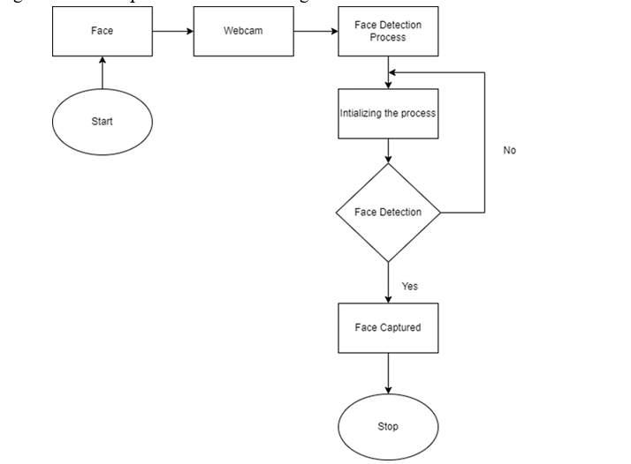
face detection
Face detection is the process to analyze visual data to determine the presence, location, size, and often orientation of faces within a digital image or video frame.
This involves use various techniques, including traditional image processing methods and advanced machine learning algorithms (such as Convolutional Neural Networks) to achieve accurate and reliable face detection.
Flowchart for face detection

Slide 9
CNN Components
Convolutional layers
Convolutional layers apply convolution operations to the input data using filters
These filters slide over the input to detect patterns, edges, and textures at different spatial positions
Activation function
After the convolution operation, an activation function like ReLU (Rectified Linear Unit) is applied element-wise to introduce non-linearity.
ReLU helps the network learn complex patterns and relationships within the data by introducing non-linearities into the model.
Pooling layers
Pooling layers down sample the spatial dimensions of the previous layer's output (feature maps) while retaining the most important information.
Common pooling operations include max-pooling and average-pooling.

Slide 10
Fully Connected Layers
In CNNs, these layers are typically found towards the end of the network and are responsible for making predictions using softmax (multi-class) or sigmoid (binary).
Dropout
Dropout is a regularization technique which helps prevent overfitting
Padding
Padding involves adding extra border pixels around the input data.
Dropout improves the network's generalization ability.
Before passing the output of the pooling layers to the fully connected layers, the multi-dimensional tensor is flattened into a one-dimensional vector known as flattening.
It is especially useful in preserving information at the edges of images.
Normalization helps stabilize and speed up the training process by ensuring that the inputs to activation functions are within a certain range.
Padding ensures that the spatial dimensions of the feature maps remain consistent after convolution and pooling operations.

Slide 11
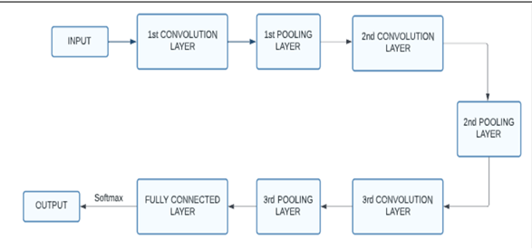
BLOCK Diagram of CNN

Slide 12
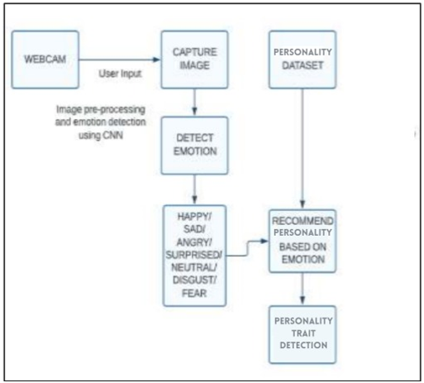
TECHNICAL DIAGRAM
The System design of emotion personality detection system

Slide 13

QR CODE(LINK) FOR SRS

Slide 14
Methodology
Data Collection:
Gather diverse datasets for facial expressions
Data preprocessing: cleaning data to remove noise and extracting relevant features
Training CNN for facial recognition using the training data
Real time recognition: Implementing the trained models into the system for instant emotion recognition
Evaluation & Optimization

Slide 15
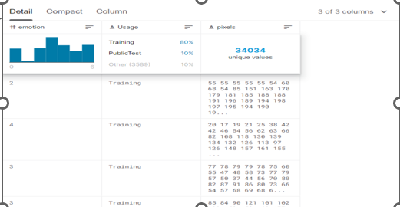
Methodology
Dataset
We used the FER 2013 dataset available on Kaggle. The dataset contains CSV files that map the emotion labels to the respective pixel values of the image at hand.
It has 7 emotions/classes (0=Angry, 1=Disgust, 2=Fear, 3=Happy, 4=Sad, 5=Surprise, 6=Neutral) and as visible in the overview below, the classes are a little skewed.

Slide 16
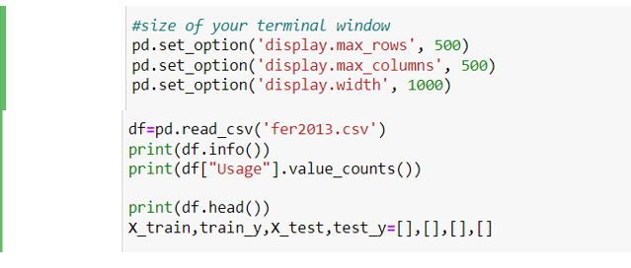
Methodology
Size of our terminal window and reading CSV file(2013)
These statements sets the maximum width to 1000 pixels per column.

Slide 17
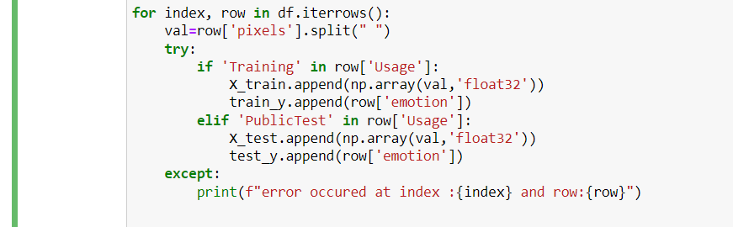
Methodology
Loaded data in arrays by iterating every row

Slide 18
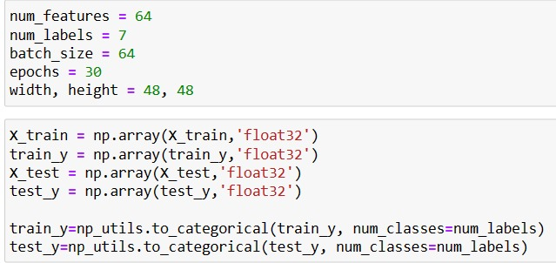
Methodology
Defining the Model
We have converted our loaded data to numpy array and defined our dataset as categorical data. We have trained 30 epochs for this purpose.

Slide 19
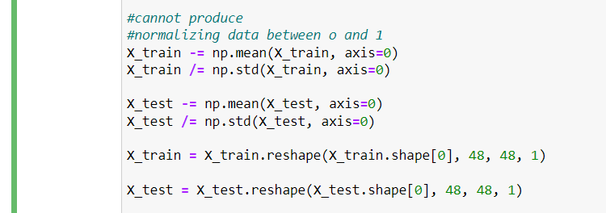
Methodology
Normalization
We have normalised our data to reduce computational power and time.

Slide 20
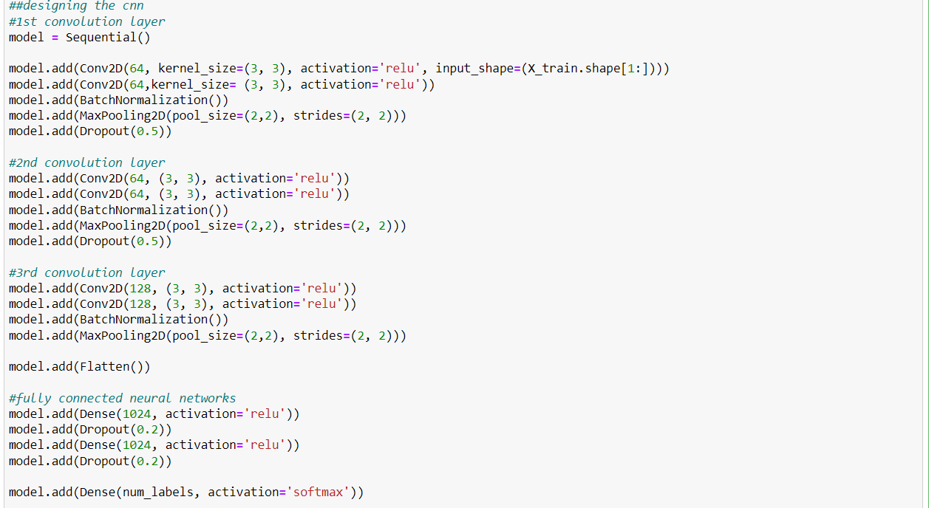
Methodology
We have defined a CNN model here with 3 convolutional layers and a fully connected layer. We have used activation function ReLu and softmax function for classifying the emotions (multi class classification)

Slide 21
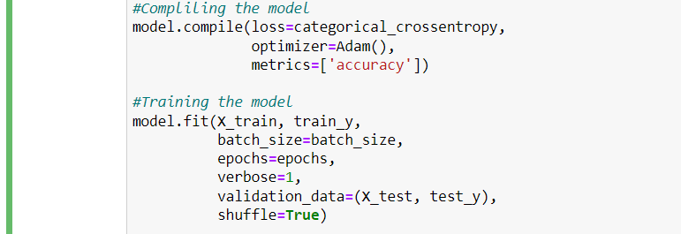
Methodology
Compiling and Training the Model
Here we are Compiling and training our model

Slide 22
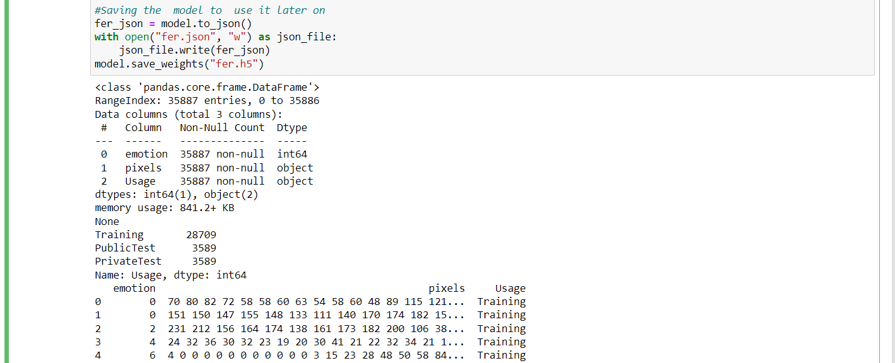
Methodology
Saving the model to use it later on

Slide 23
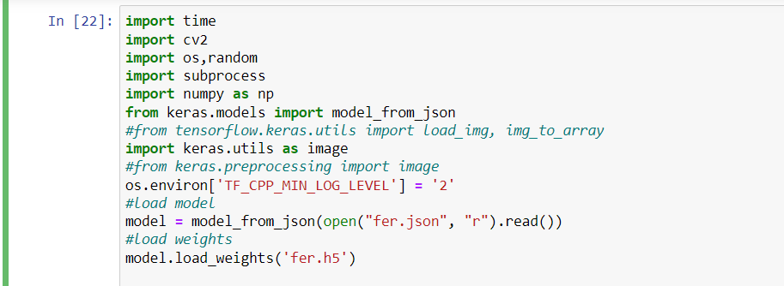
Methodology
Implementing the model in Real-Time : Loading Model and weights from the model above

Slide 24
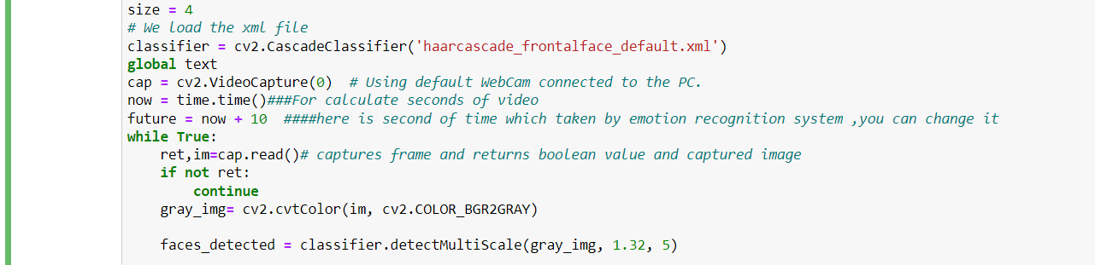
Methodology
Implementing the model in Real-Time : We will download the file ‘haarcascade_frontalface_default.xml’, which is a file containing the features required to detect the frontal face.
cv2.VideoCapture(0) starts the webcam and captures images from the webcam which are passed into the cascade classifier to detect the face in the image.

Slide 25

Methodology
The detected face is then converted to a grayscale image and resized into a shape that is compatible with our model. Then it is passed to the model for predicting the emotion.

Slide 26
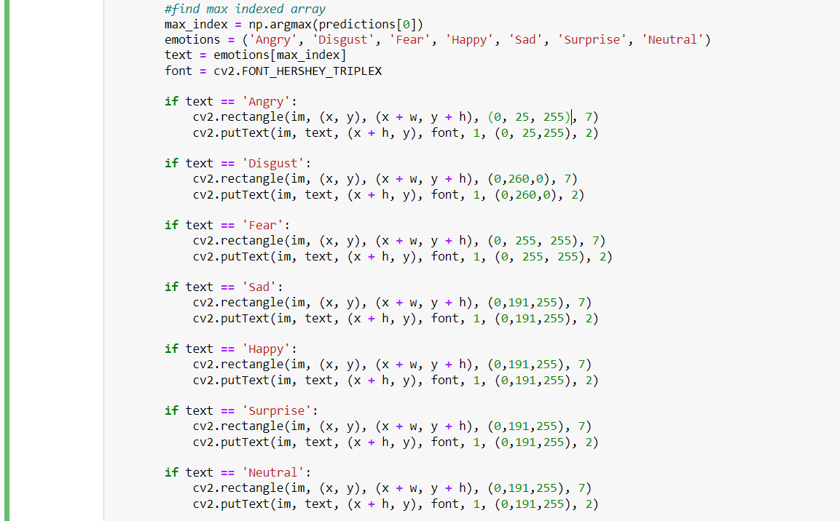
Methodology
Implementing the model in Real-Time: Defining image, start_point, end_point, color, thickness of the rectangle

Slide 27
Results For emotion Detection
Results for real time facial detection and emotion recognition
Neutral face detected
Emotion fear detected

Slide 28
Happy face detected
Anger detected
Sadness detected

Slide 29
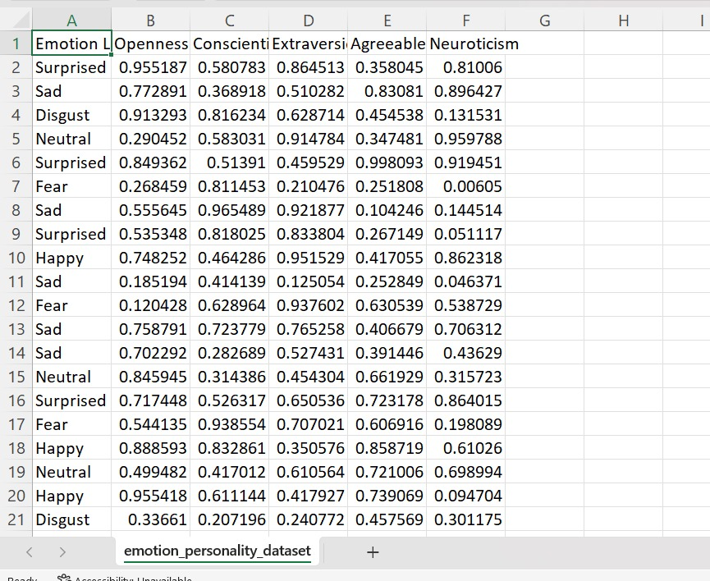
Dataset used for personality trait prediction
The dataset used for personality trait prediction had 7 emotions & traits of BIG FIVE personality.
Big five personality traits are:
Agreeableness, reflects a person's interpersonal style and how they relate to others.
Openness, willingness to engage in new and unconventional ideas or experiences
Conscientiousness, Conscientiousness relates to how organized, responsible, and reliable a person is.
Extraversion, measures the degree to which a person is outgoing, social, and energetic.
Neuroticism, Neuroticism measures the tendency to experience negative emotions such as anxiety, depression, and insecurity.

Slide 30
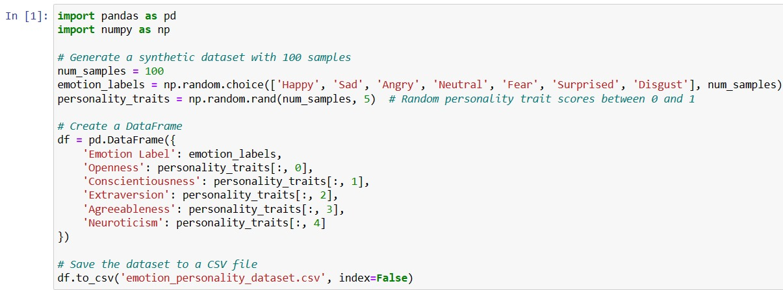
Code for generation of dataset

Slide 31
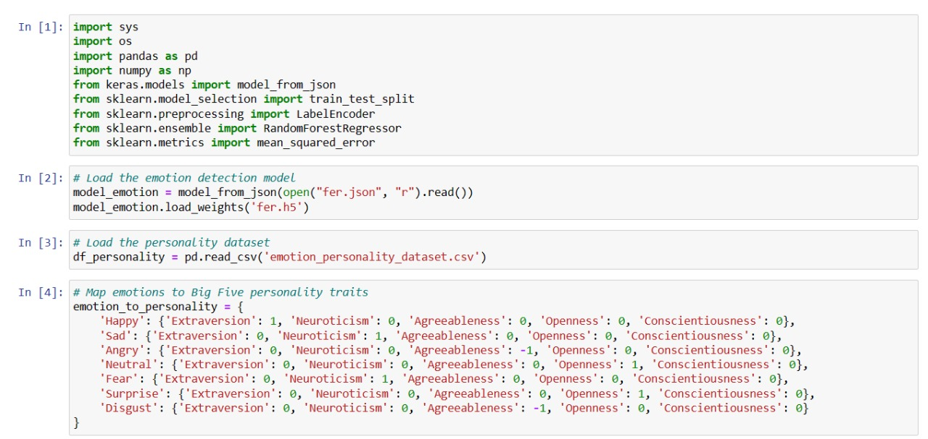
Calling the emotion prediction model & mapping emotions to BIG FIVE PERSONALITY TRAITS

Slide 32
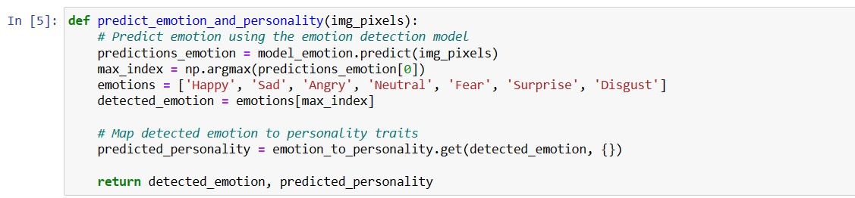
Function for Mapping the emotions to personality traits

Slide 33
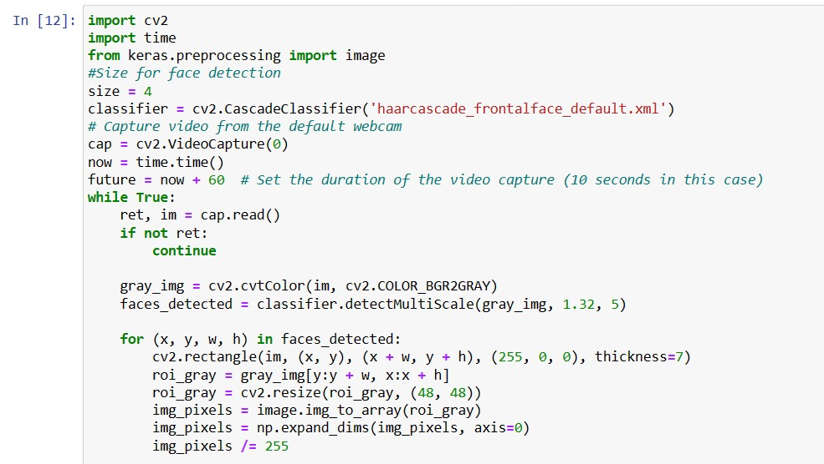
Real time personality trait prediction Capturing video from the default webcam for a duration of 10-60 seconds, performing face detection, and predicting emotion and personality trait based on it

Slide 34
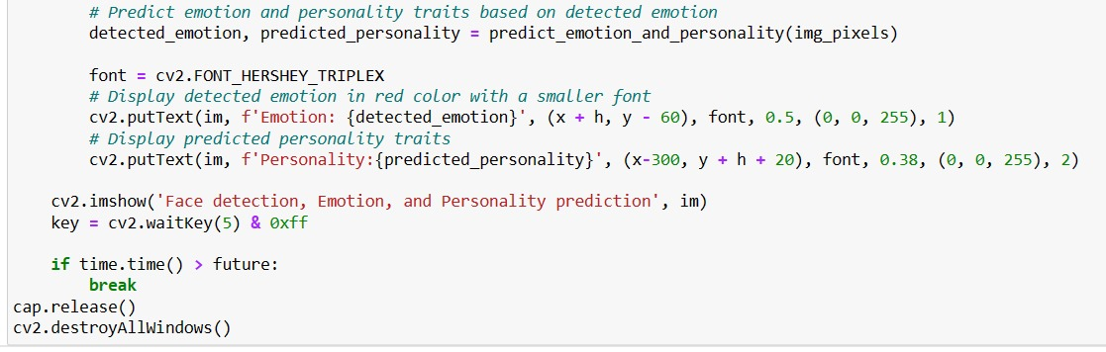
Predicting personality traits based on emotion

Slide 35
Results for personality trait prediction using predicted emotion
Emotion: Disgust Personality trait: Disagreeableness
Emotion: Happy/ Neutral Personality trait: Openness
Emotion: Angry(sidelook) Personality trait: Disagreeableness

Slide 36
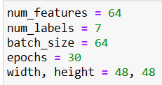
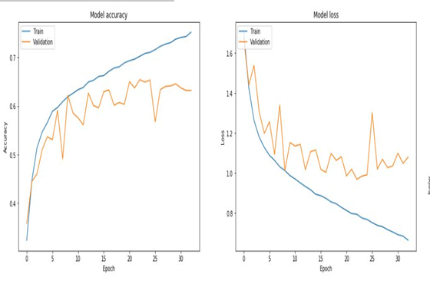
Results and Discussions
A total of 95,239 photos were used to train the final network, which was then evaluated using 24022 images. In the end, the model had an 85.8% accuracy rate and 60% validation accuracy rate.
Following are the essentials we provided to the network to be trained upon and it took about 1.5 hours for model to process 30 epochs.
Outcome Graphs:

Slide 37
Reference
[1] "A Convolutional Neural Network for Facial Expression Recognition" by Zhang, Z., & Zou, D. in IEEE International Conference on Automatic Face & Gesture Recognition (FG 2016).
[2] "Deep Facial Expression Recognition: A Survey" by Mollahosseini, A., Chan, D., & Mahoor, M. H. in arXiv (2016).
[3] "Emotion Recognition via Convolutional Neural Networks and Mapped Binary Patterns" by Mollahosseini, A., Hasani, B., & Mahoor, M. H. in Proceedings of ACM International Conference on Multimodal Interaction (ICMI 2016).
[4] “Multitask Learning for Emotion and Personality Detection·” Yang Li, Amirmohammad Kazameini, Yash Mehta, Erik Cambria · (jan 2021)
[5] Yujun Yang, Jianping Li and Yimei Yang,” The research of the fast SVM classifier method,” 2015
[6] Lee, Hyeon-Jung, and Kwang-Seok Hong. ” A study on emotion recognition method and its application using face image.” 2017 International Conference on Information.
[7] “Facial expression analysis for automatic prediction of personality traits"Authors: P. Liu, S. Han, and Z. MengPublished in: 2017 IEEE International Conference on Multimedia and Expo (ICME)
[8] "Automatic Personality Perception: Prediction of Trait Attribution Based on Face“ Authors: N. Dhall, et al.Published in: IEEE Transactions on Affective Computing, 2015

Slide 38
Thank You

